Slide 1
Cryptography.
Design Problem 4

Slide 2
Agenda
Problem Background
Learning Objectives
Coding

Slide 3
Cryptanalysis was a defining factor in WWII.

Slide 4


Slide 5
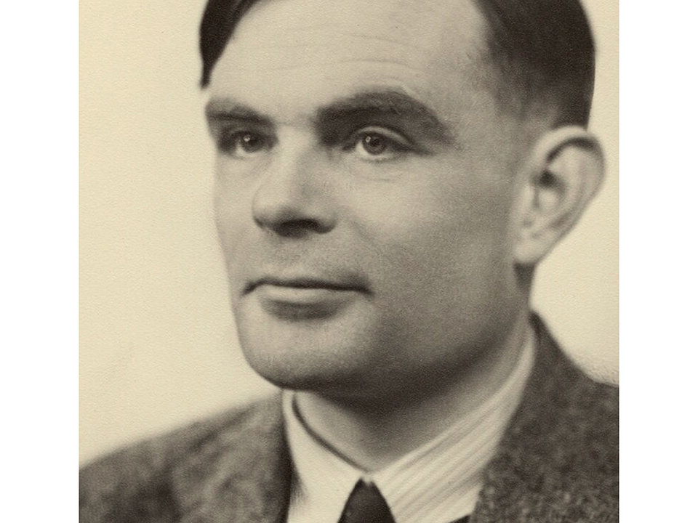
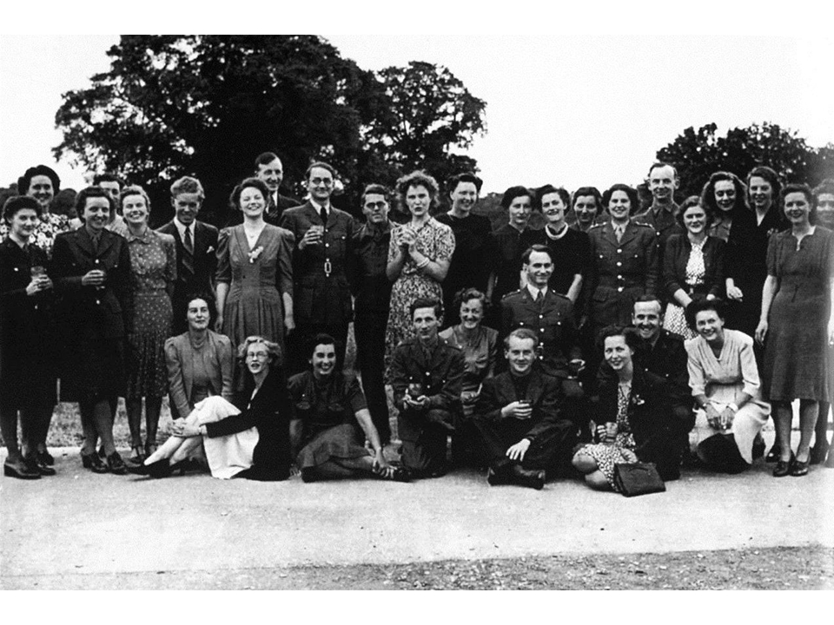
Intersectionality of history and technology
Alan Turing
Pioneered the technology to decrypt Nazi Germany's secret communications during World War II.
These were called “Turing machines”.
Alan Turing circa 1951
Workers of Bletchley Park circa 1938

Slide 6
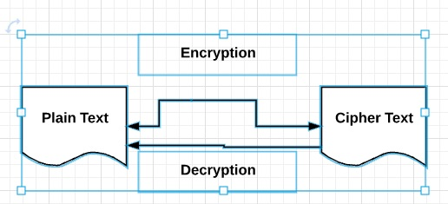
Background
Will rely on user input, functions, for loops, conditional statements, ASCII codes, string methods, and comparison operators to create our own cryptography code!
Goal: Write a Python program that enables us to encrypt a message that can only be read by someone with the secret key.

Slide 7
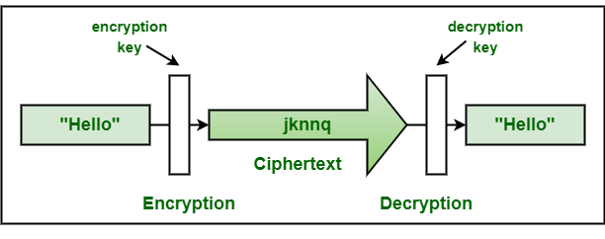
Learning Objectives
Practice combining all topics covered so far with an out-of-box application.

Slide 8
Engineering Design Process
Learn to define the problem.
Practice defining test cases.
Develop an algorithm plan (i.e. a workflow!).
Program your solution and debugging.

Slide 9
Some reminders.

Slide 10
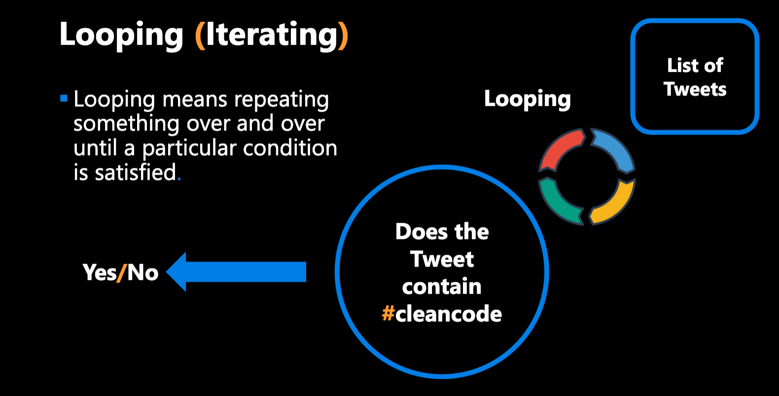

Slide 11
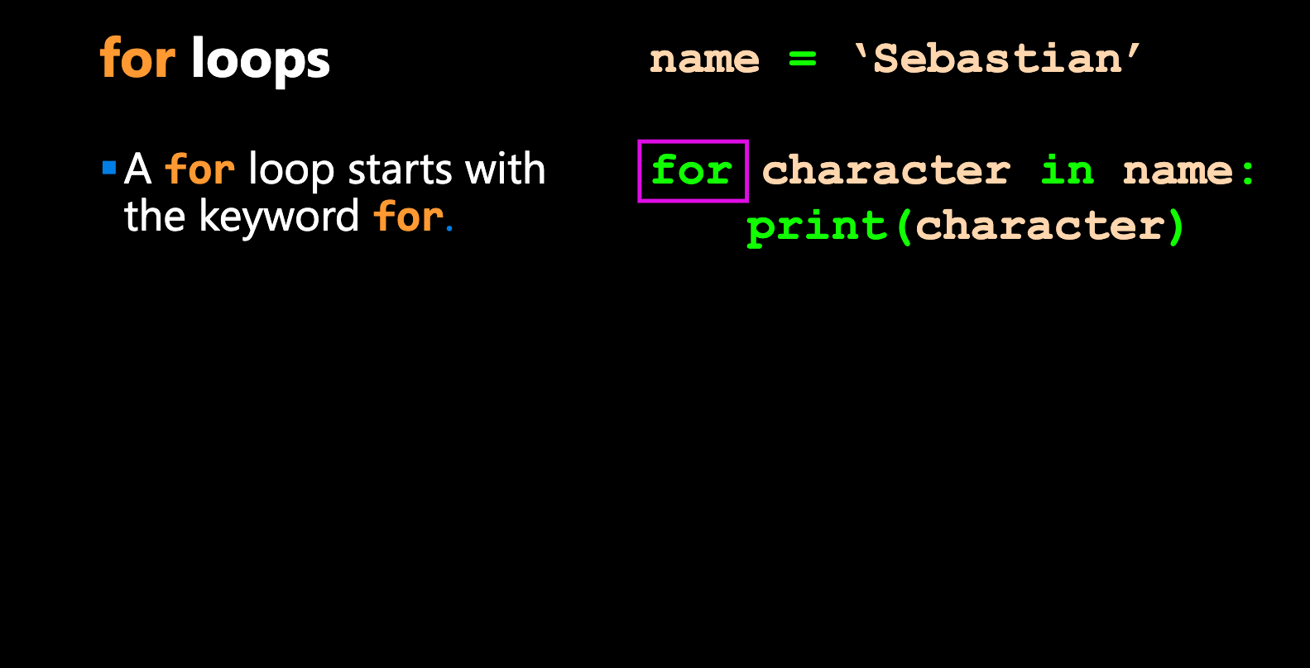

Slide 12
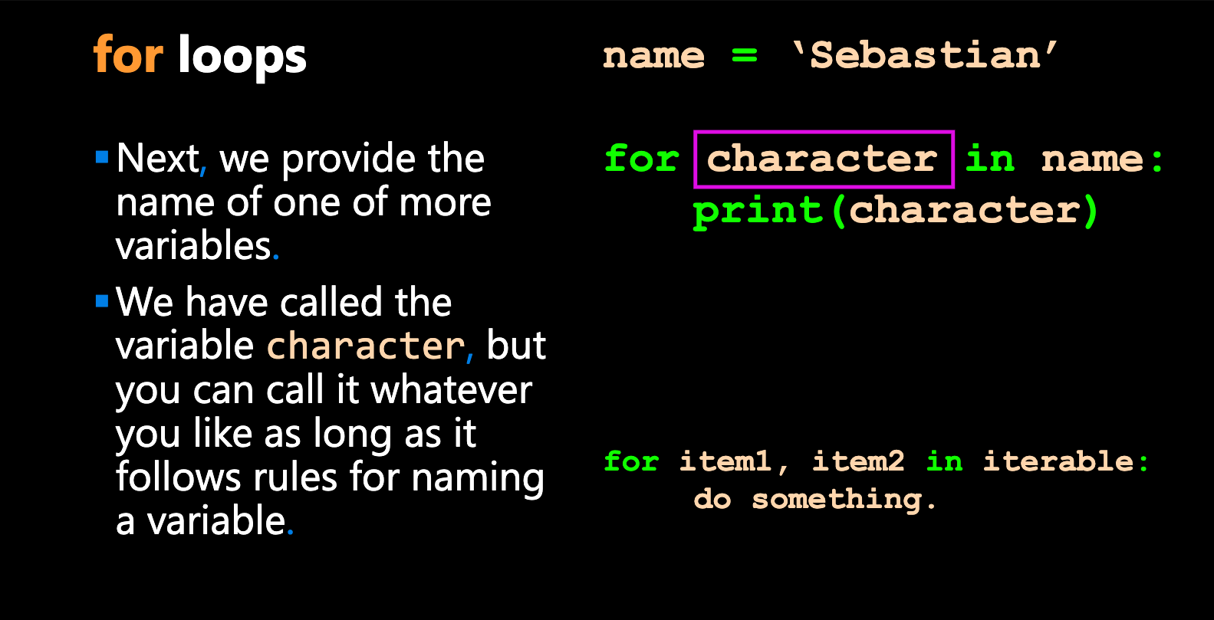

Slide 13
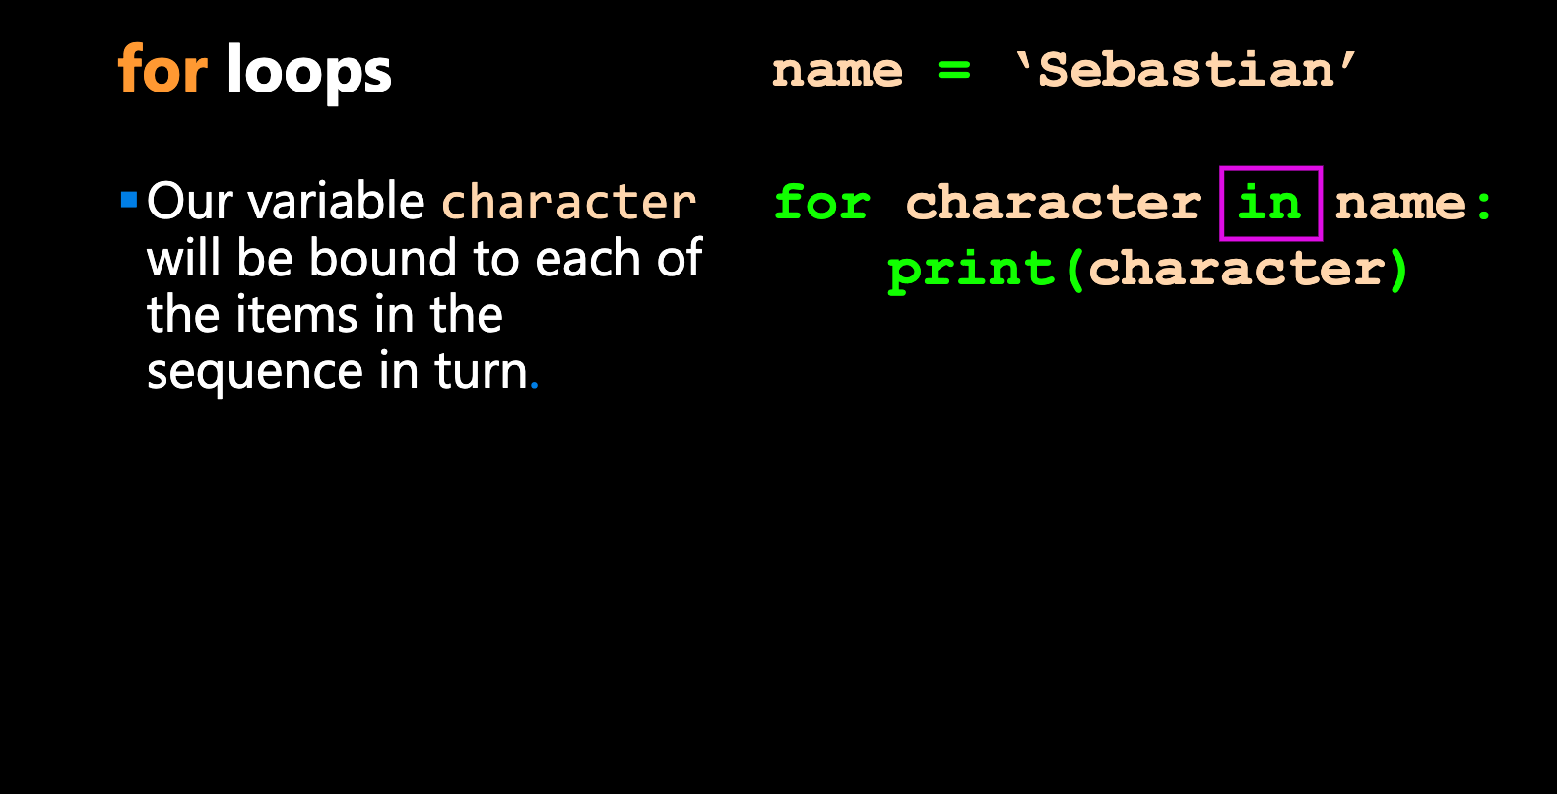

Slide 14
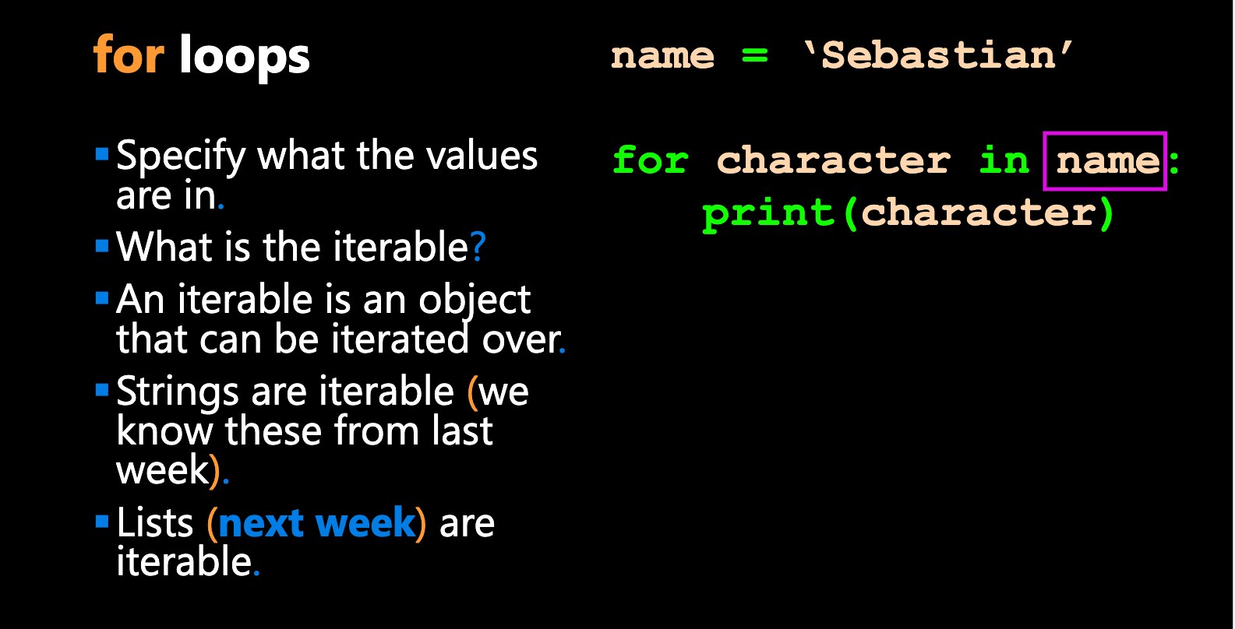


Slide 15
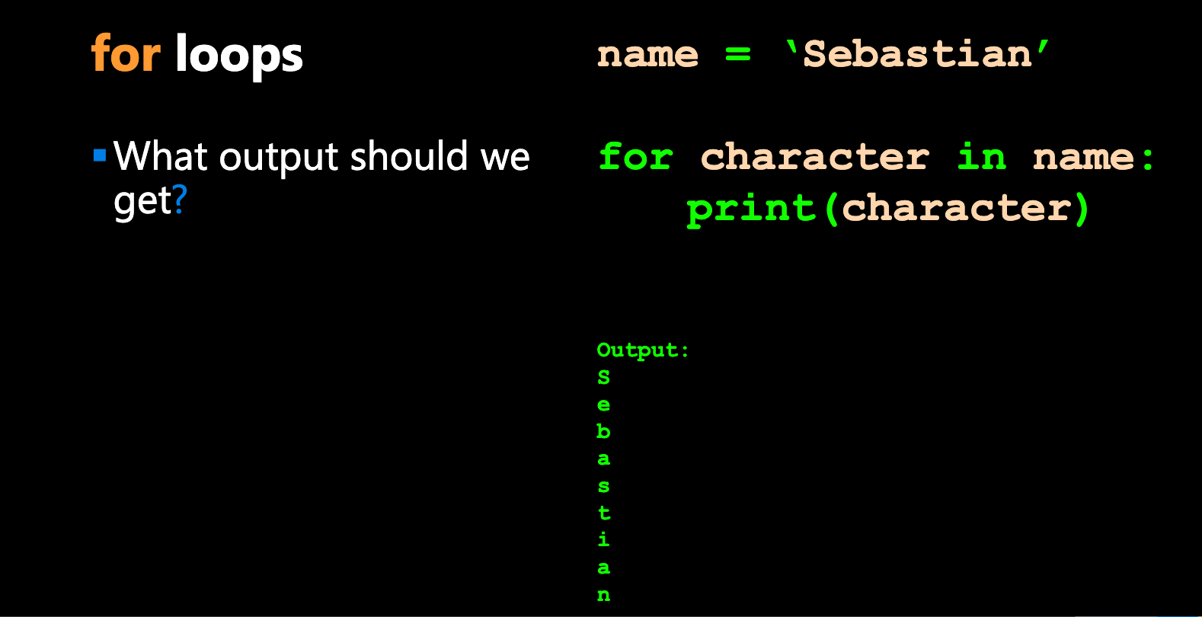

Slide 16
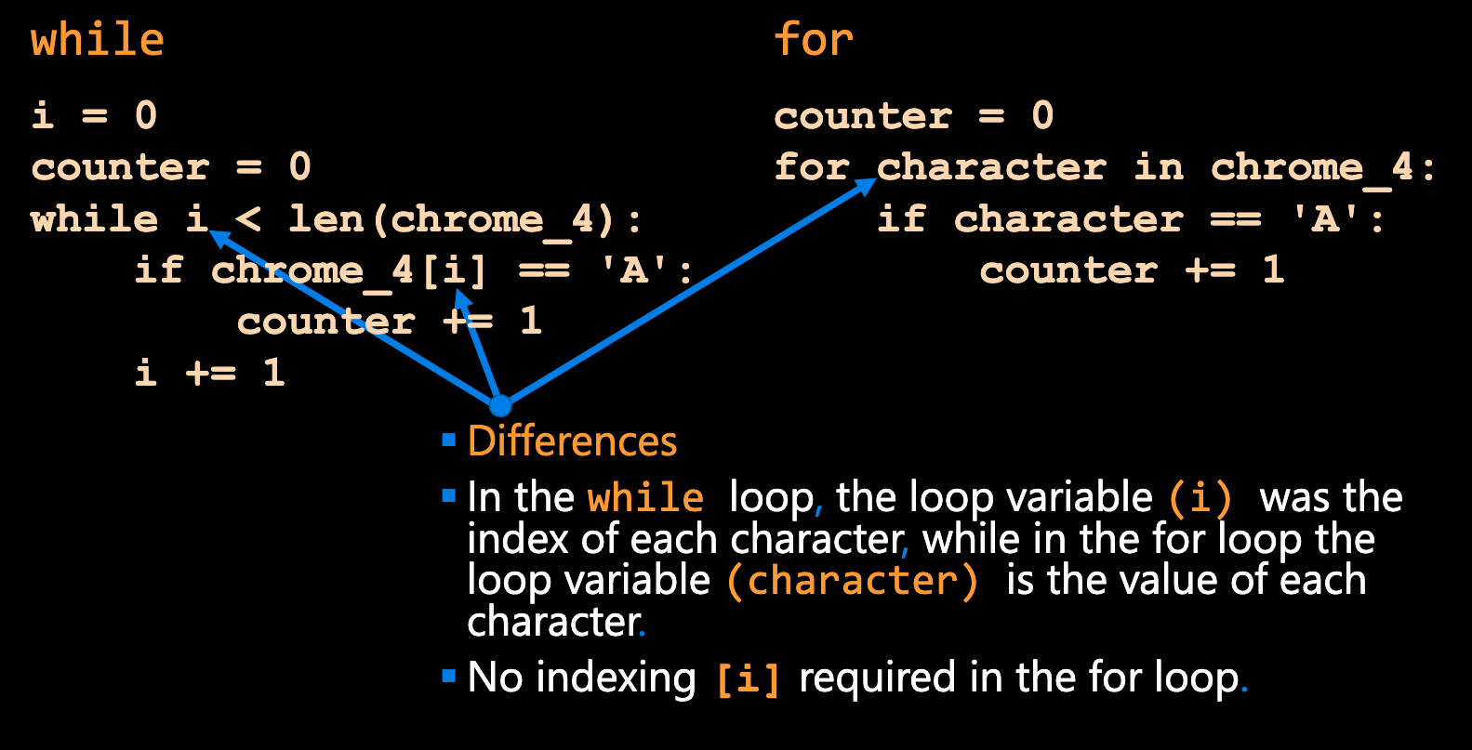

Slide 17
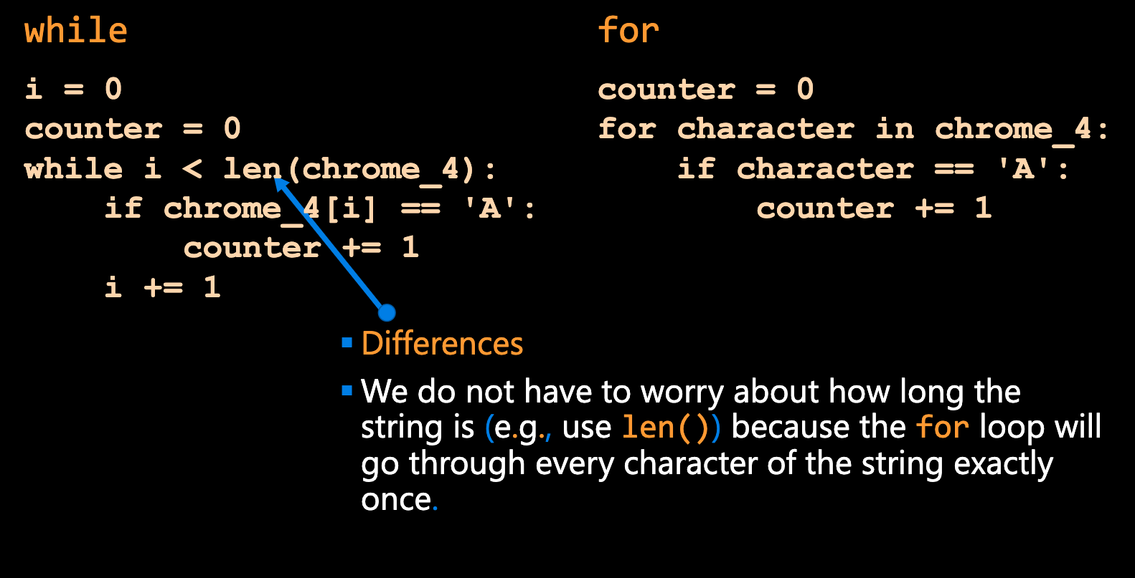

Slide 18
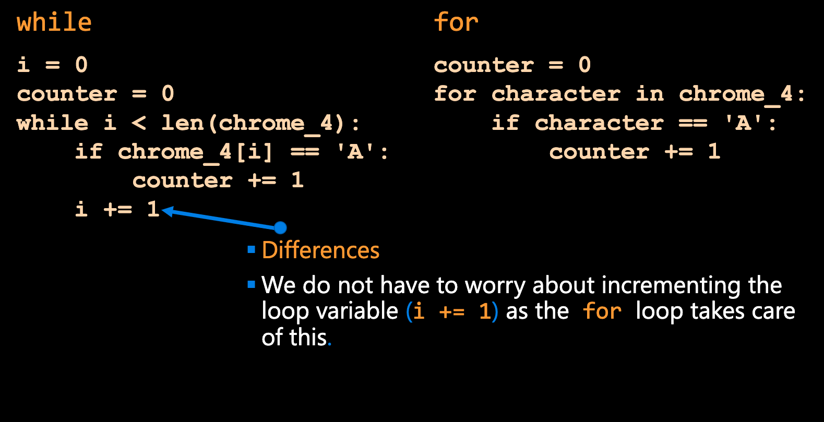

Slide 19
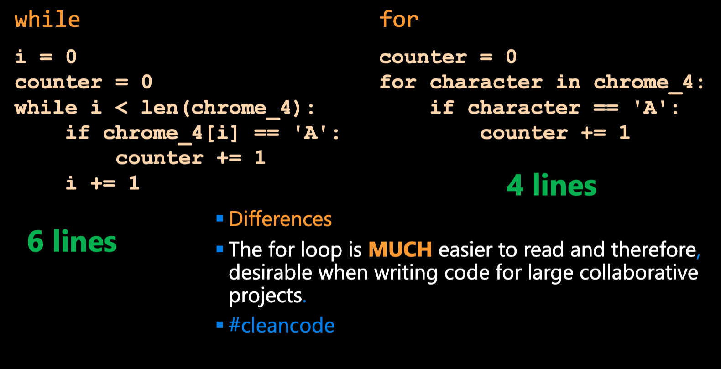

Slide 20
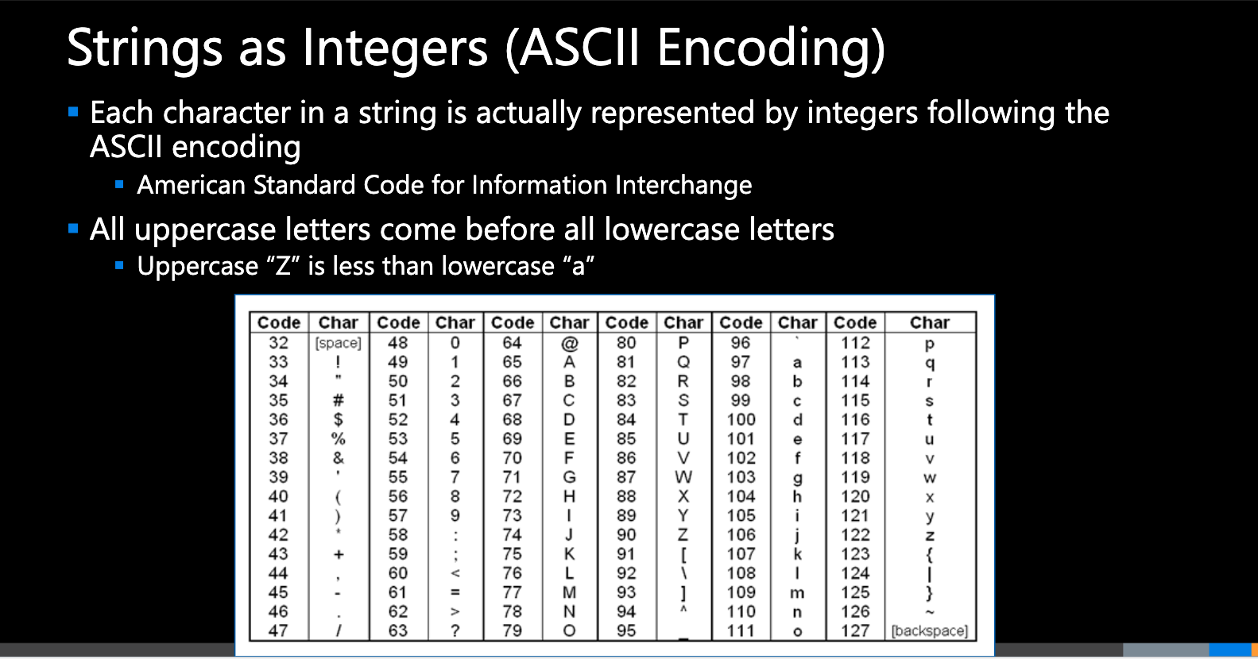

Slide 21
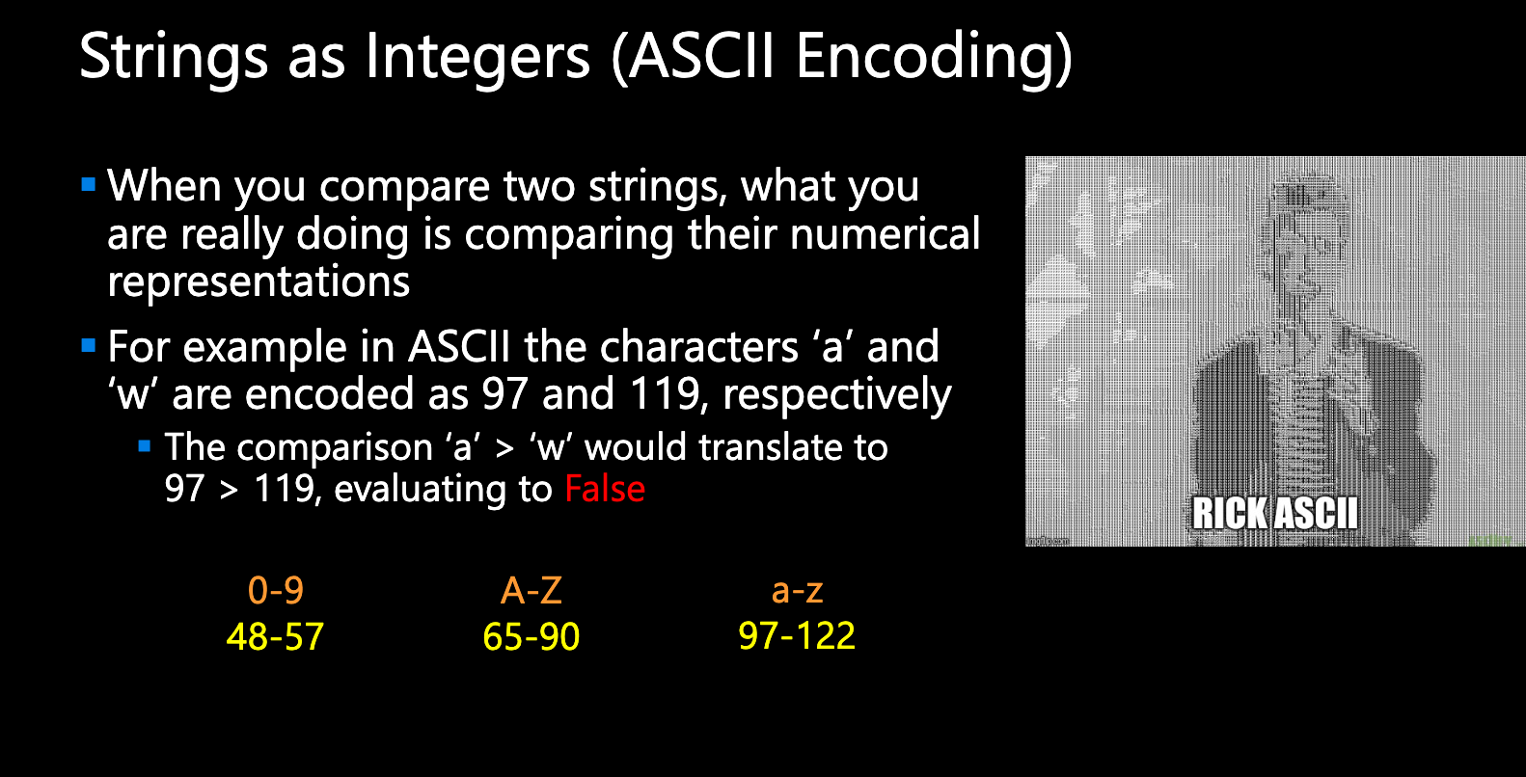

Slide 22
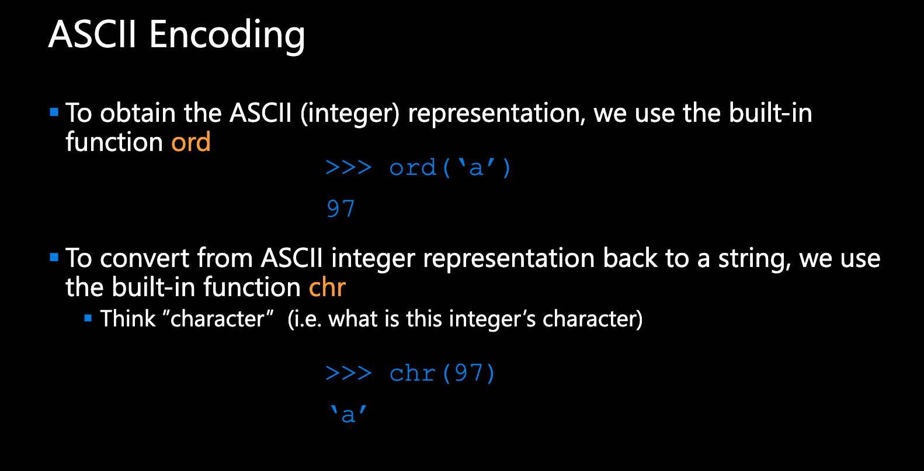

Slide 23

RECAP: Making Choices
statements
Sequential structure
statements
Conditional structure
if
True
condition
statements
statements
statements
False
statements

Slide 24


Adding the elif (else if) statement
The most general form of the if conditional statement is:
if condition1:
body1
elif condition2:
body2
elif conditionN:
bodyN
else:
other_body
Note the colons (:) and the indents!
ONLY 1 body will be executed.
if statement is True, execute body1, exits if structure
if statement is False, continue to elif statement
elif statement is True, execute elif body, exits if structure
elif statement is False, continue to next elif statement
All if’s and elif’s are False, execute else statement

Slide 25
Making Choices
statements
True
if
condition
Conditional structure
False
statements
elif
True
condition
statements
False
else
statements

Slide 26
Function Definitions
Definition
Function Name
Colon
def function_body(parameters):
body
Indent
(parameter1,
parameter2, …)
What is in the body?

Slide 27
Function Definitions
def function_body(parameters):
1. “““DOCSTRING””” (optional)
2. Code the does the thing
3. return [expression]
The return statement is options and if it is not included, it’s the same as writing return None

Slide 28
Calling Functions
In Python names of variables and functions use low case and underscores.
function_name
Function_Name
FunctionName
The general form of a function call:
Terminology
argument: a value given to a function.
pass: to provide an argument to a function.
call: ask Python to execute a function (by name).
return: give a value back to where the function was called from.
function_name(arguments)

Slide 29
Input
Python has a built-in function named input for reading text from the user.
The general form of a input function call:
The argument is the text you want displayed to the user.
“What is your name?”
The value returned by the input function is always a string.
input(argument)

Slide 30
Cryptography.
Design Problem 4

